Slide 1

AI Agents in Excel and Copilot Studio
George Mount
Stringfest Analytics

Slide 2
Objectives For Today
Integrate and execute Agent Mode in Excel to build analytical and reporting tools and workflows.
Design and deploy lightweight agents in Copilot Studio to perform repetitive data analysis tasks.
Demonstrate how agentic AI can extend across Microsoft 365 tools such as Power BI and Teams.
Apply best practices for guiding and supervising AI agents to ensure data accuracy and compliance.

Slide 3
Schedule For Today
Module 1: Agent Mode and Pre-Built Agents
Module 2: Build an Excel Chatbot in Copilot Studio
Module 3: Building and Deploying an Automated AI Workflow

Slide 4

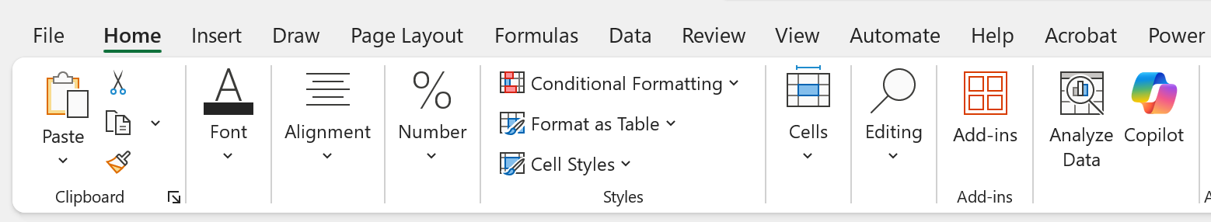
Pulse Check
Do you have access to Copilot in Excel?
Home > Copilot

Slide 5
Pulse Check
Do you have access to Agent Mode in Excel Online?
Available via the Frontier program

Slide 6
Pulse Check
Do you have access to Copilot Studio?
Free trial available: https://learn.microsoft.com/en-us/microsoft-copilot-studio/requirements-licensing-subscriptions

Slide 7
I. Agent Mode and Pre-Built Agents
What Excel features does Python in Excel depend on?
Formulas
PivotTables
Power Query
Copilot
Data Remember when Excel got…
Now it’s getting Agents!

Slide 8
Exercise
Using the Researcher & Analyst agents in Excel
Dataset: researcher-analyst.xlsx
Researcher helps you understand the broader context around your data.
Analyst performs calculations and generates insights directly from your tables.
Together they show Excel’s shift from simple prompts to agent-driven reasoning.
Notes:
The key to #2 is using “Unpivot All” in Power Query. If you're not sure how to do this, feel free to skip it and just load the data into Excel for now. But take this as a sign—it might be worth brushing up a bit on Power Query before diving deeper into Python in Excel!

Slide 9
What does Microsoft mean by “agent?”
An agent is an AI system that can understand goals, reason about steps, and take actions to complete a task.
Goes beyond Q&A → performs multi-step workflows driven by user intent.
Uses memory, tools, and environment signals to stay on track.
Designed to be autonomous but bounded (rules, safety, context).
Notes:
Could help you create charts or summaries quickly, or maybe it could even help you take your analysis one level deeper with predictive analytics, unstructured data or charts that are otherwise difficult to build in Excel

Slide 10
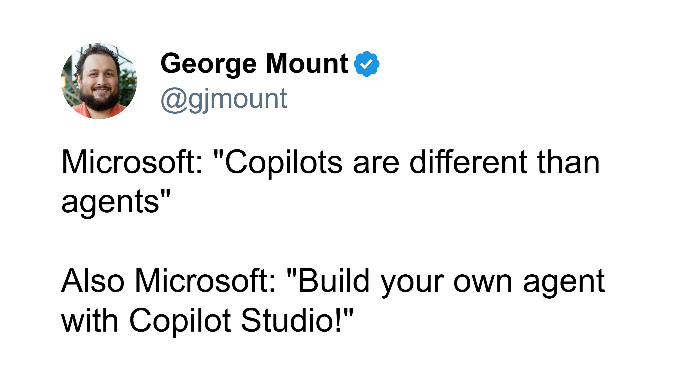
The lines are sometimes not so clear…
Notes:
Could help you create charts or summaries quickly, or maybe it could even help you take your analysis one level deeper with predictive analytics, unstructured data or charts that are otherwise difficult to build in Excel

Slide 11
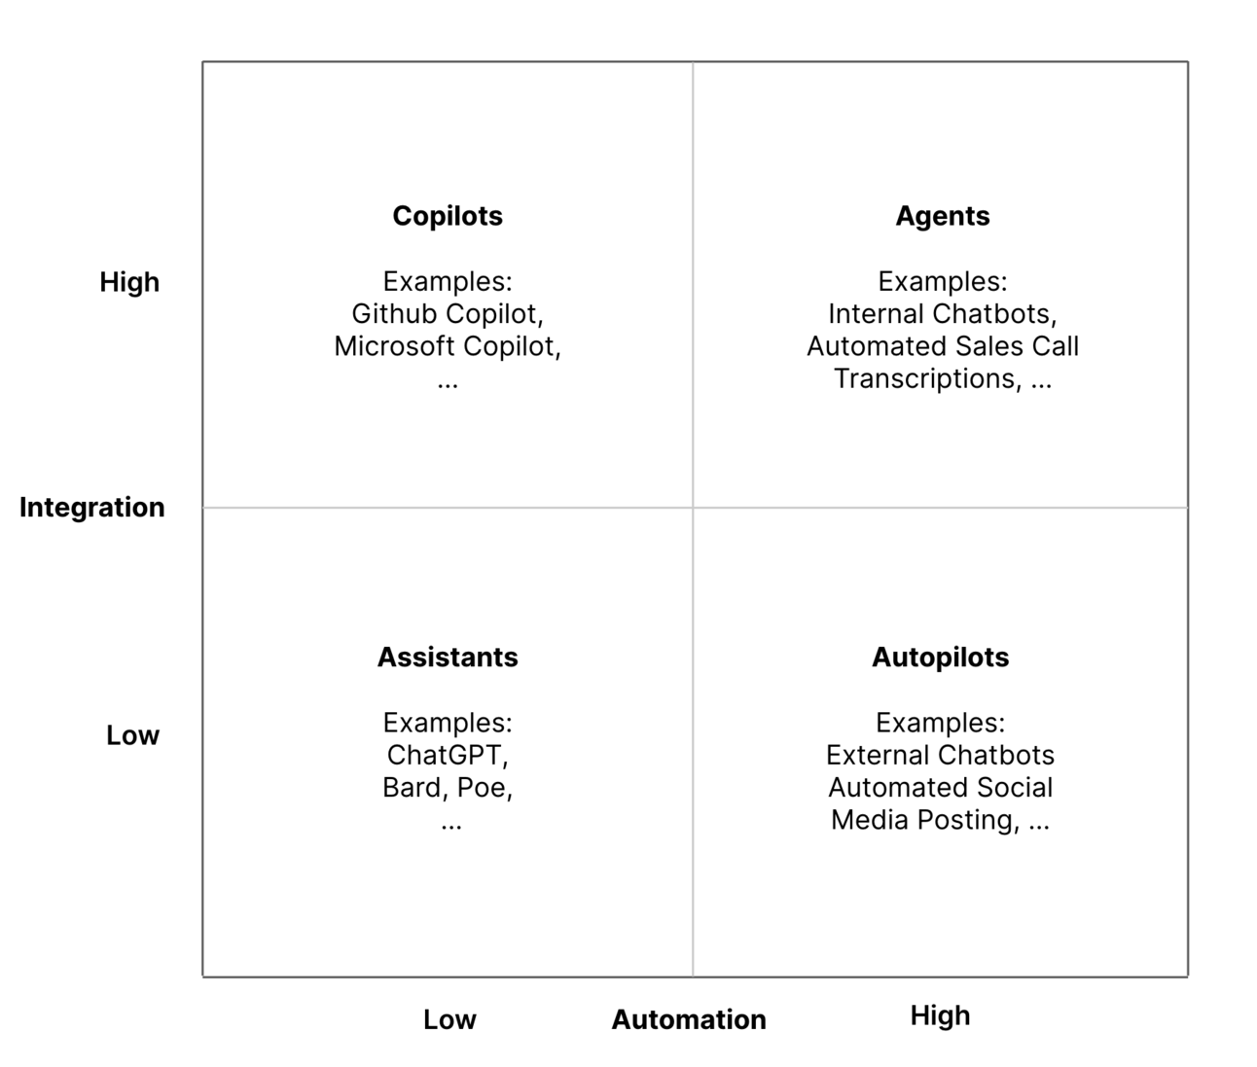
The integration-automation AI framework
Source: https://blog.tobiaszwingmann.com/p/integration-automation-ai-framework
Notes:
Could help you create charts or summaries quickly, or maybe it could even help you take your analysis one level deeper with predictive analytics, unstructured data or charts that are otherwise difficult to build in Excel

Slide 12
The integration-automation AI framework
Source: https://blog.tobiaszwingmann.com/p/integration-automation-ai-framework
Notes:
Could help you create charts or summaries quickly, or maybe it could even help you take your analysis one level deeper with predictive analytics, unstructured data or charts that are otherwise difficult to build in Excel

Slide 13
Discussion
Have you tried Copilot in Excel? What have you liked and disliked about it?
Where could Excel benefit you further with agentic assistance?
Notes:
Could help you create charts or summaries quickly, or maybe it could even help you take your analysis one level deeper with predictive analytics, unstructured data or charts that are otherwise difficult to build in Excel

Slide 14
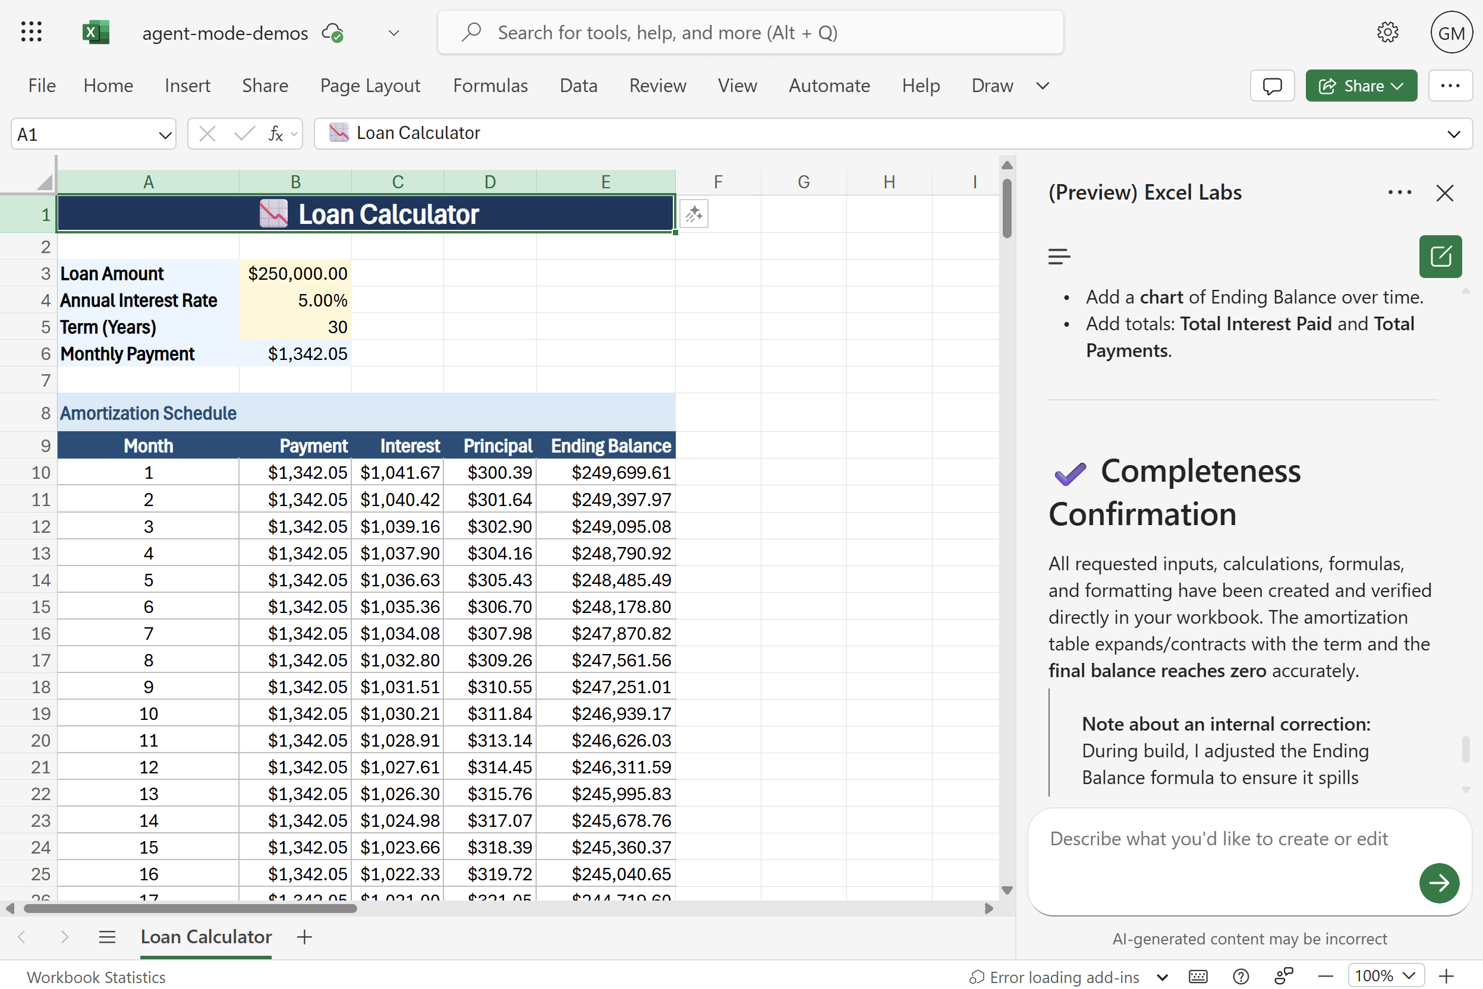
Exercise
Exploring Agent Mode
Dataset: agent-mode.xlsx
Use cases:
Loan calculator
Variance analysis
Monthly close pack
What does Agent Mode do well, poorly, or not at all?
How does this relate to other tools in the Excel AI stack?
Notes:
The key to #2 is using “Unpivot All” in Power Query. If you're not sure how to do this, feel free to skip it and just load the data into Excel for now. But take this as a sign—it might be worth brushing up a bit on Power Query before diving deeper into Python in Excel!

Slide 15
Excel Copilot versus Excel Agent Mode
Feature | Excel Copilot | Agent Mode
Interaction | One-shot prompts | Iterative, self-guided workflow
Task Scope | Single actions (formulas, charts, summaries) | Multi-step processes across sheets
Error Handling | User re-prompts or fixes | Agent reviews, retries, self-corrects
User Role | You do, Copilot helps | You manage, Agent executes
Output Quality | Fast but shallow | Verified and repeatable
Best For | Quick wins, ad-hoc tasks | Structured, high-stakes workflows
Analogy | Smart assistant | Junior analyst
Notes:
Could help you create charts or summaries quickly, or maybe it could even help you take your analysis one level deeper with predictive analytics, unstructured data or charts that are otherwise difficult to build in Excel

Slide 16
Questions?
Notes:
You will be able to see questions as they come in. Some instructors like to include this slide as a visual reminder to check the Q&A widget, but it’s not required.

Slide 17
Break
Notes:
Breaks are flexible in On24. At the end of your deck you’ll have 5 minute, 7 minute, 10 minute, and 15 minute timers that you will be able to push to the audience whenever you want. Some presenters like to include this break slide as a visual reminder, but it’s not required.

Slide 18
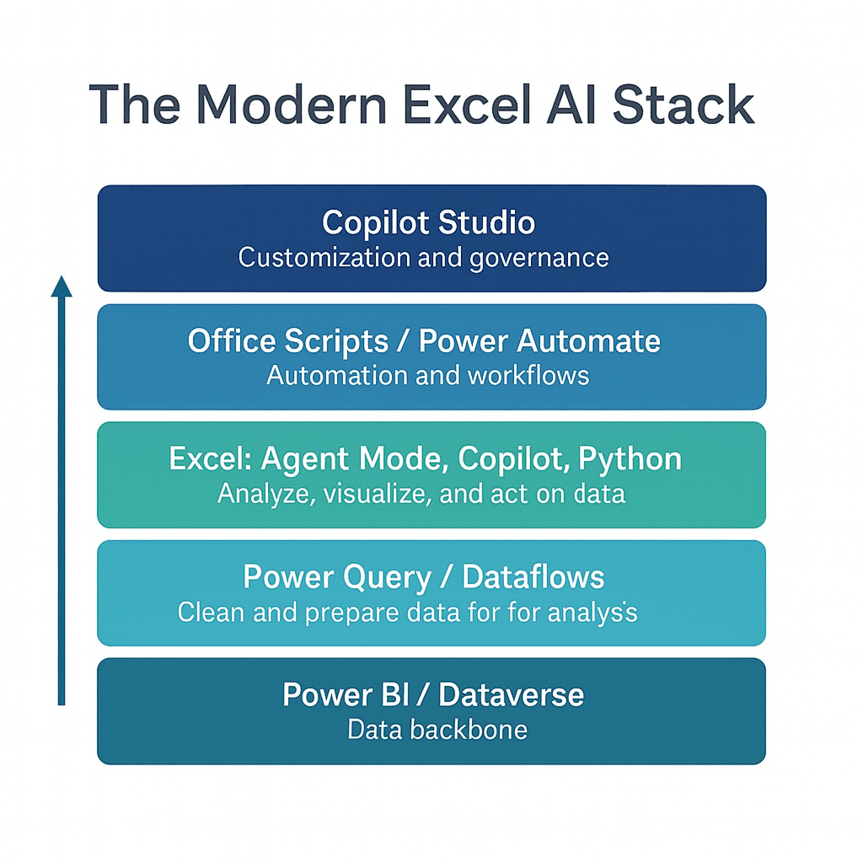
Understanding the Modern Excel AI stack
Notes:
Could help you create charts or summaries quickly, or maybe it could even help you take your analysis one level deeper with predictive analytics, unstructured data or charts that are otherwise difficult to build in Excel

Slide 19
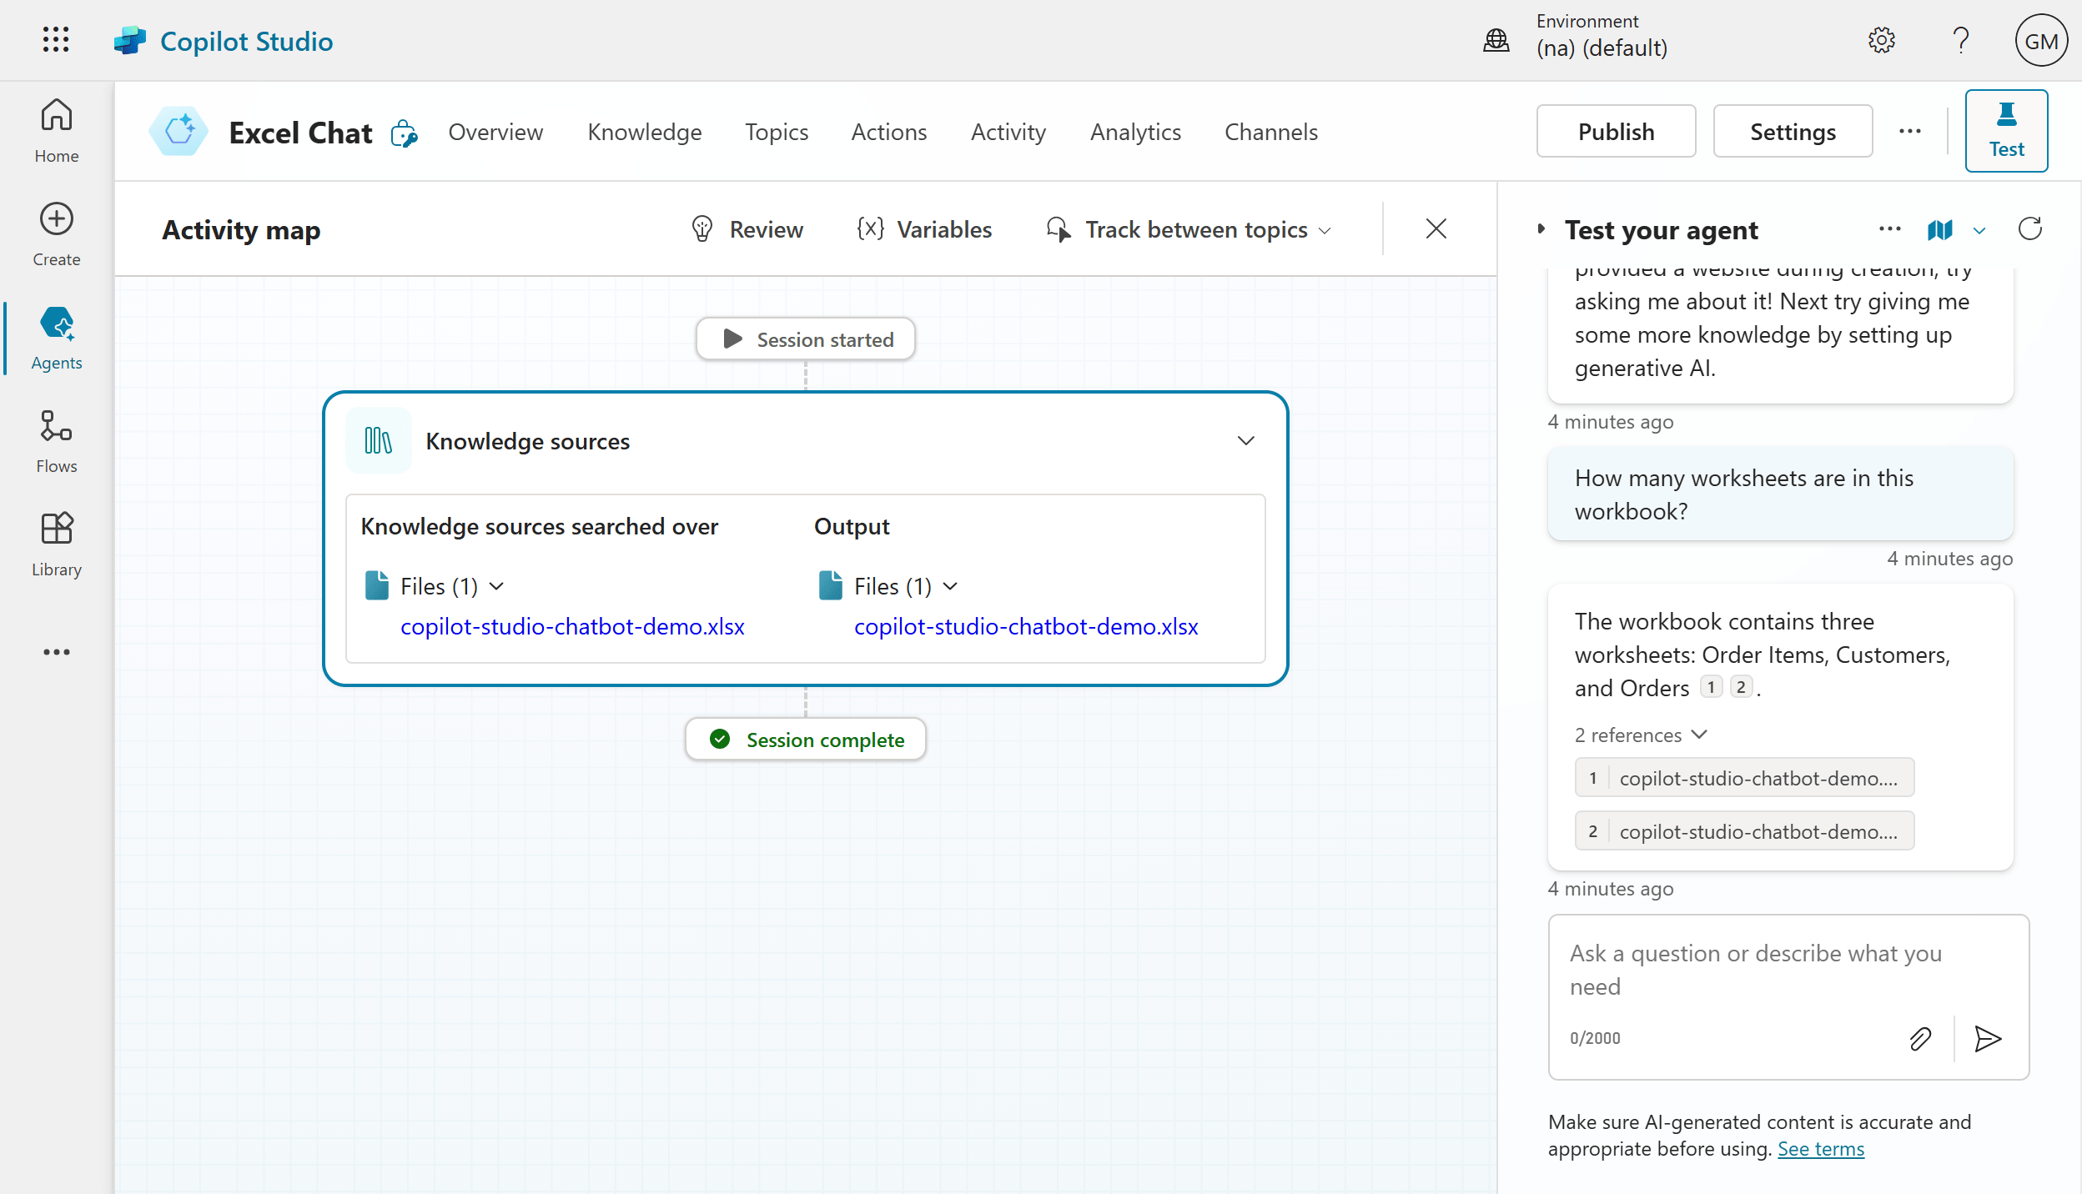
Demo
Build an Excel chatbot in Copilot Studio
Create a custom Copilot agent in Copilot Studio tailored for specific Excel-related use cases
Add and manage trusted knowledge sources (like MVP websites) to ensure high-quality, domain-specific responses
Test and publish the agent with simple topics added
File: mvp-knowledge-base-instructions.docx
Notes:
The key to #2 is using “Unpivot All” in Power Query. If you're not sure how to do this, feel free to skip it and just load the data into Excel for now. But take this as a sign—it might be worth brushing up a bit on Power Query before diving deeper into Python in Excel!

Slide 20
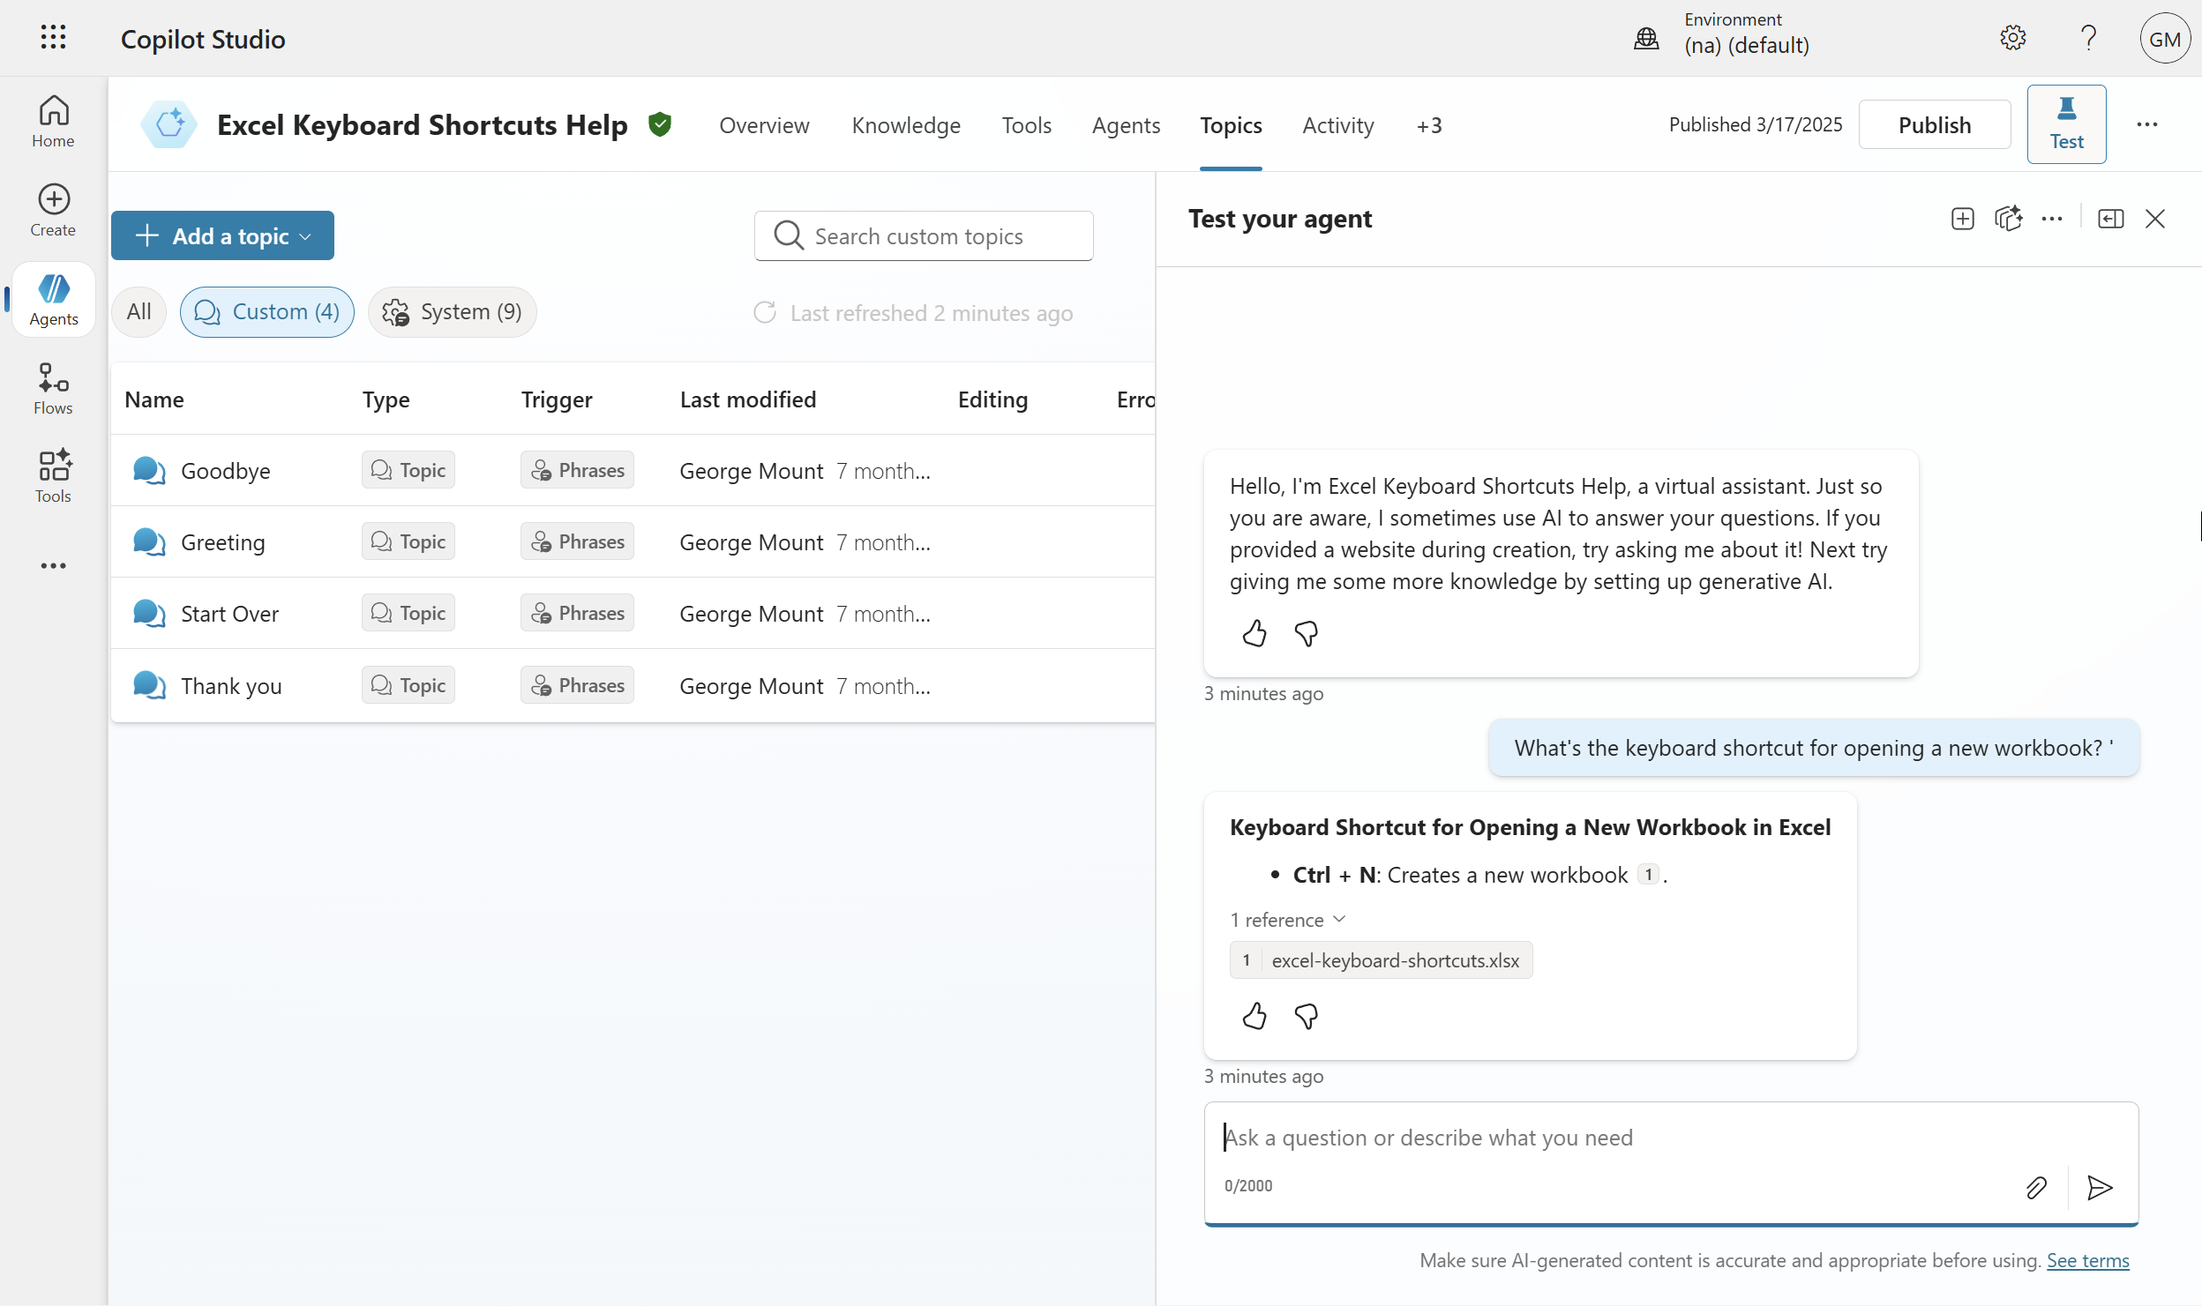
Exercise
Create an Excel keyboard shortcut chatbot for Teams
Folder: copilot-studio-exercise
Create a chatbot that helps users find Excel keyboard shortcuts, using only the provided “Excel keyboard shortcuts” cheat sheet as its knowledge base
Edit the “goodbye” topic to replace the default response (“okay, goodbye”) with a more engaging sign-off like “Keep on excelling,” then save and test
Publish the chatbot and launch it in Microsoft Teams to see it running inside an external app
Notes:
The key to #2 is using “Unpivot All” in Power Query. If you're not sure how to do this, feel free to skip it and just load the data into Excel for now. But take this as a sign—it might be worth brushing up a bit on Power Query before diving deeper into Python in Excel!

Slide 21
Questions?
Notes:
You will be able to see questions as they come in. Some instructors like to include this slide as a visual reminder to check the Q&A widget, but it’s not required.

Slide 22
Break
Notes:
Breaks are flexible in On24. At the end of your deck you’ll have 5 minute, 7 minute, 10 minute, and 15 minute timers that you will be able to push to the audience whenever you want. Some presenters like to include this break slide as a visual reminder, but it’s not required.

Slide 23
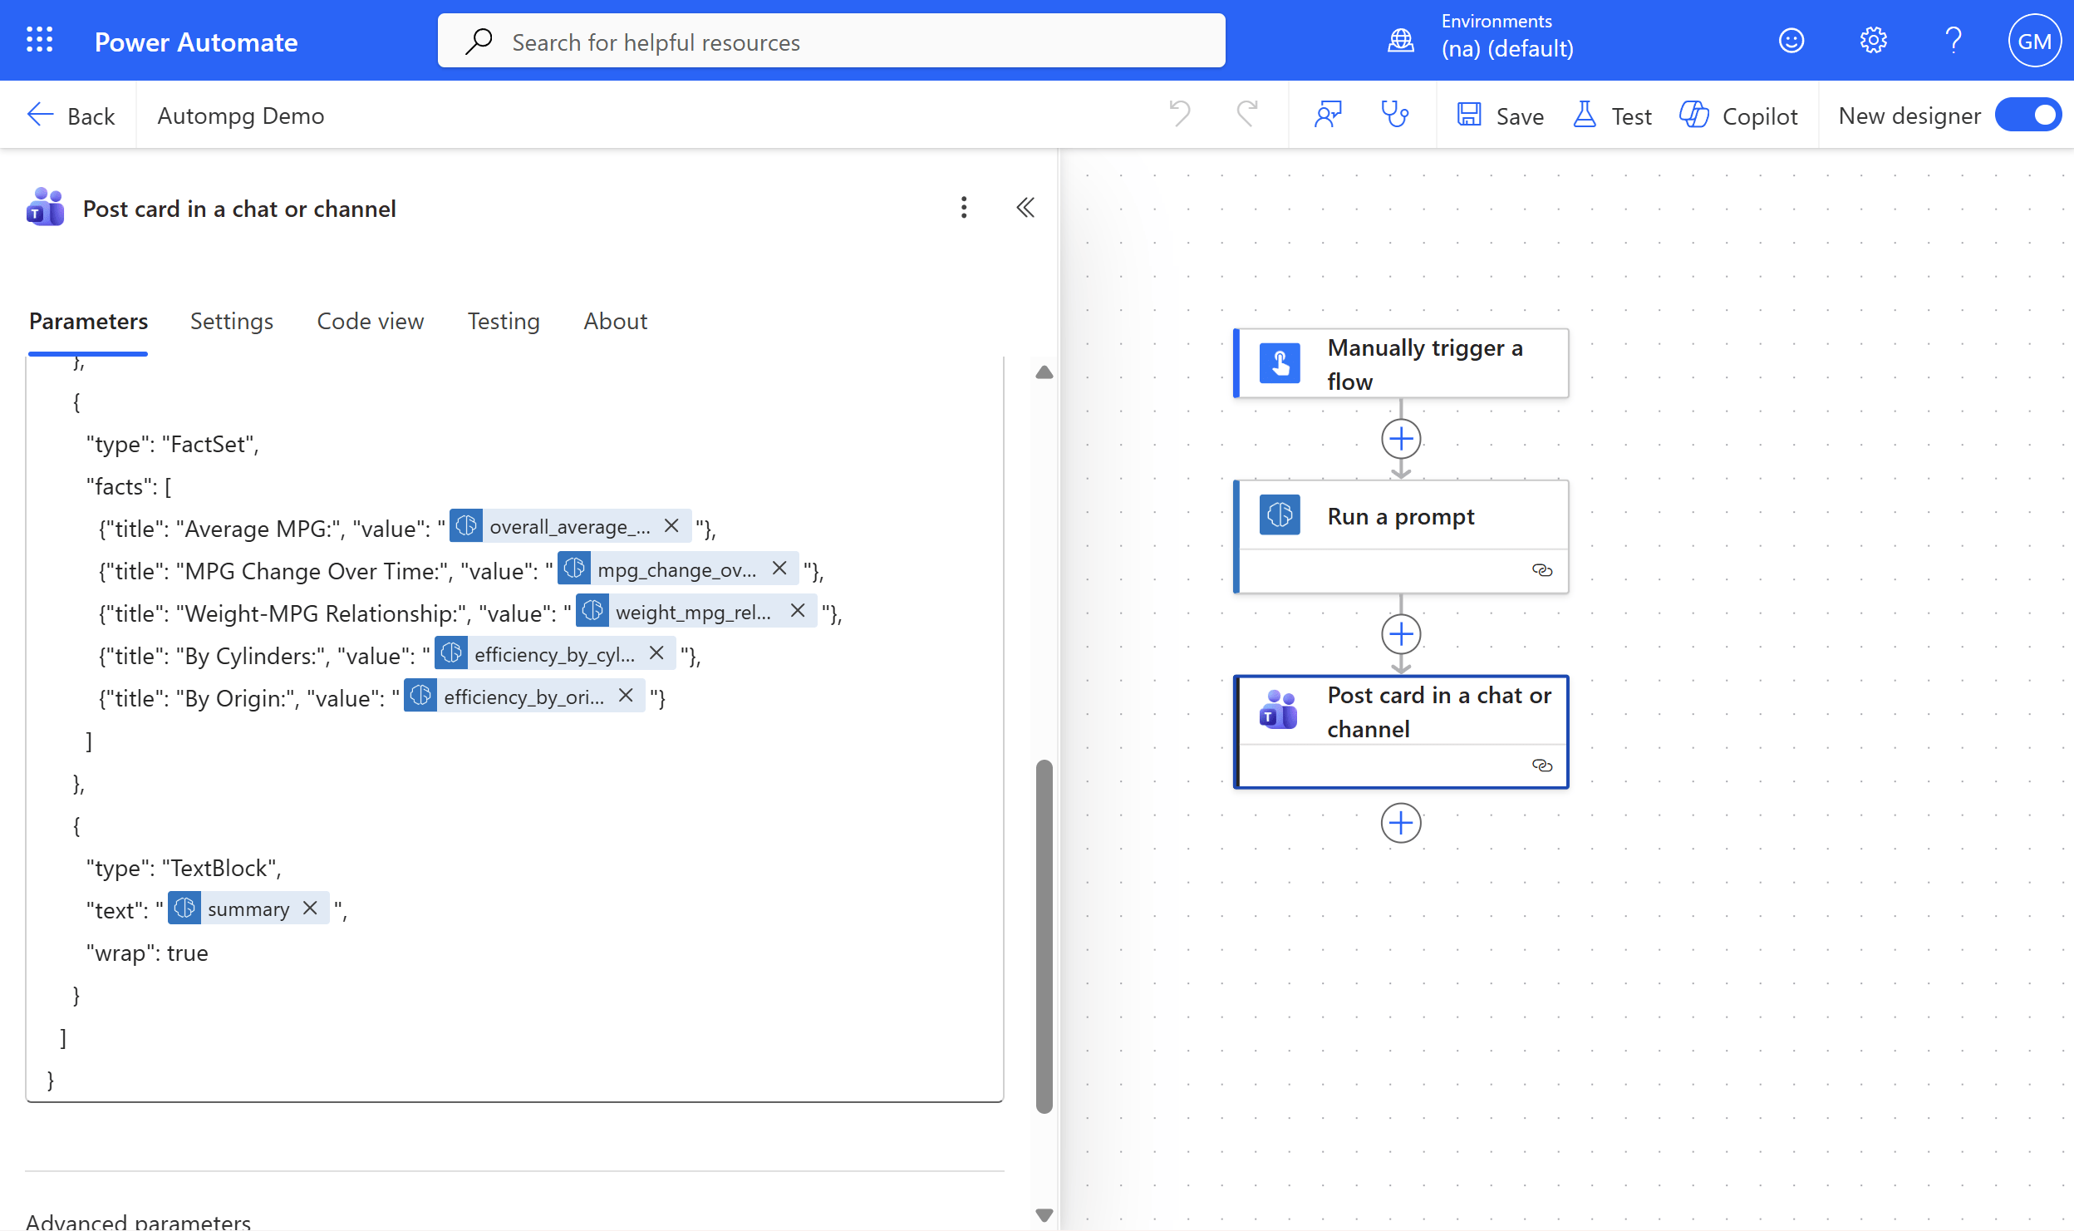
III. Building and deploying an AI-powered workflow
Live Demo: Build an AI-Powered Excel Report
Dataset: autompg.xlsx
Load Excel data into Dataverse
Create a flow in Power Automate
Run AI prompt as part of the flow
Switch prompt to structured JSON output
Build and map an Adaptive Card for Teams
Run the flow and review the generated report
“Look, don’t touch:” I will run this demo solo due to licensing restrictions
Notes:
I’m assuming people do NOT all have access to the tools here. I am going to run, “look don’t touch” style. So many steps otherwise.

Slide 24
Questions?
Notes:
You will be able to see questions as they come in. Some instructors like to include this slide as a visual reminder to check the Q&A widget, but it’s not required.

Slide 25
Recap: Understanding the Modern Excel AI stack
Notes:
Walk through where we have used each tool (and where we could still explore here!)

Slide 26
Key Takeaways For Today
Agent Mode is a new way of working in Excel, more goal driven and less step by step
Human analysts still provide direction, judgment, and guardrails
Copilot versus agents will stay blurry, focus on the value delivered
You do not need the full Microsoft AI stack to start seeing impact
Early adopters of agentic workflows gain a real career advantage
Notes:
Agent Mode represents a shift in how we work inside Excel. Instead of building everything step by step, we can describe the outcome we want and let the agent attempt the work. This takes Excel from being a passive tool to something that can actively help us reach a goal. It may feel new at first, but this is the direction the platform is heading.
Even with these new capabilities, human analysts remain essential. We are the ones who define the objective, check the results, and decide whether the output is correct. The tools can accelerate the work, but they still need our judgment and context. This is where analysts continue to add the most value.
The line between Copilot and agents can feel fuzzy, and that is normal. Microsoft’s terminology is evolving. What matters is understanding the strengths of each approach. Copilot is great for conversational help, while agents are better for repeatable tasks and guided objectives. Instead of worrying about labels, we look at the value each tool provides.
You do not need the entire Microsoft AI stack to benefit from what you are learning today. Even if you do not have Dataverse or Copilot Studio at work, these concepts will improve how you use Copilot and Excel in your current environment. The mindset of setting goals and supervising AI applies everywhere.
Finally, this is still an emerging space. By learning agentic workflows early, you position yourself ahead of the curve. As these tools continue to mature, the people who understand how they fit together will have a real advantage in shaping how their organizations work with data.

Slide 27
Recommended Resources
Available on O’Reilly Online Learning:
Read Microsoft Copilot Studio Quick Start
Read Learning Generative AI Tools for Excel
Take “Copilot in Microsoft 365: A Practical Introduction to Working with Generative AI in Microsoft 365”
Read The Profitable AI Advantage

Slide 28
Get in touch
Get in touch
stringfestanalytics.com: Subscribe for more content and updates
Check your resource folder for curated posts on these topics
linkedin.com/in/gjmount: Follow for all things AI for Excel

Slide 29
Takeaways
Next steps
A quick survey will appear on your screen soon… we’d love to hear your thoughts
You’ll receive a recording via email within 24-48 hours.
Thanks so much for joining -- hope to see you at future events!

Slide 30
Q&A
Notes:
You will be able to see questions as they come in. Some instructors like to include this slide as a visual reminder to check the Q&A widget, but it’s not required.

Slide 31


Slide 32
Poll: What will you ask attendees?
Polls are a great way to check in with attendees! You can ask them about their opinions, experience level, or quiz their knowledge. We find that 1-3 poll questions per hour is best.
Poll answer 1
Poll answer 2
Poll answer 3

Slide 33
Discussion Question
What should attendees think about? Ask a prompt question that attendees can answer in the group chat.

